Slide 1
Health Professions Program Orientation

Slide 2
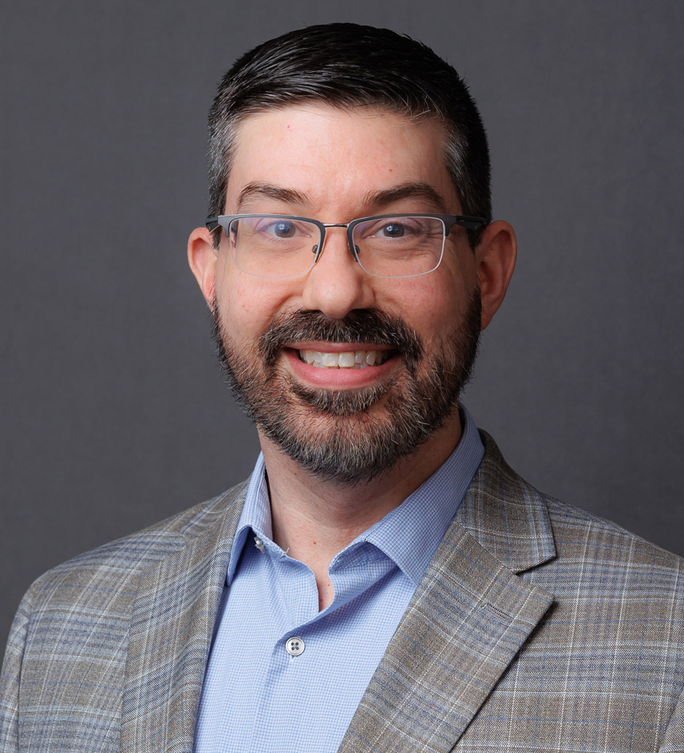
WELCOME AND CONGRATULATIONS!
Congratulations on your acceptance into a highly competitive program!
Dr. Allen Kotun
Dean, School of Health Professions and Science
AK

Slide 3
WELCOME…
Shawn Fortley
Healthcare Records Coordinator
School of Health Professions and Science
JB

Slide 4
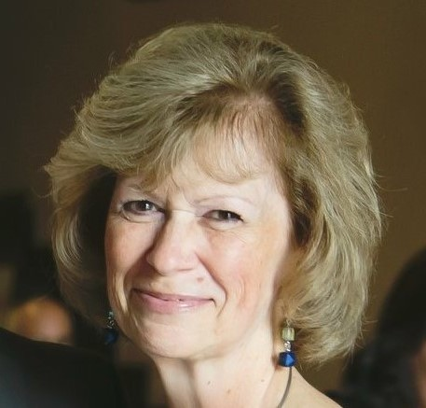
WELCOME…
Jaye Brennan
Project and Credentialing Coordinator,
School of Health Professions and Science
JB

Slide 5
OVERVIEW OF TODAY’S ORIENTATION
PA AHEC Scholars Program
Campus Resources
Accessibility Resource Center
The Libraries
Residence Halls
NCC Text Alerts
NCC-Go App
Class Schedules
Admissions Office
Advising and Registration
Health Professions Resource Center
Health Form Overview
myRecordTracker®
Program Orientations
JB

Slide 6
PA AHEC SCHOLARS PROGRAM
AHEC Scholars is a FREE two-year nationally recognized certificate program focusing on rural and/or underserved urban healthcare
Educational major eligibility:
Medical, Dental, Physician Assistant, Pharmacy, & Nursing
Yearly scholar program expectations:
40 hours community-based, experiential learning
40 hours didactic education
Benefits:
Interprofessional Experience
Clinical & Community/Research Experience
Supplemental Training Experiences
Networking & Career Advancement
Visit
https://www.paahec.org/scholars-home
For more information
Eastcentral
Liz Schaffer: eschaffer@ecpennahec.org
Northeast
info@nepa-ahec.org
AK

Slide 7
CAMPUS RESOURCES
Spartan Cares: provides assistance accessing campus and community resources for transportation, childcare, food, housing, academic support, emotional/mental health support. https://www.northampton.edu/student-experience-and-support/you-matter-at-ncc/
KEYS: provides students who receive TANF (cash assistance) or SNAP (food stamps) with services and supports such as textbooks, transportation, childcare and assistance from a KEYS facilitator to help student achieve goals. https://www.northampton.edu/student-experience-and-support/keys-program.html
Spartan Aid: can provide minimal financial assistance for qualifying students with urgent, temporary non‐academic needs. Bus passes are free for most students through Spartan Aid. Contact SpartanCares@northampton.edu for assistance.
AK

Slide 8
ACCESSIBILITY RESOURCE CENTER
Offers a wide range of support and accommodations to help students succeed academically. Some examples include:
Alternative format textbooks
Note-taking assistance
Recording lectures
Test accommodations
Sign language interpreters
Specialized academic advisement
More information can be found at: https://www.northampton.edu/student-experience-and-support/accessibility-resource-center/
AK

Slide 9
THE LIBRARIES
Bethlehem Campus Paul & Harriett Mack Library (College Center)​
Pocono Campus ESSA Bank & Trust Foundation Library (Keystone Hall)
More than books!
Guide academic research
Teach information literacy
Supportive learning spaces
Questions?
https://www.northampton.edu/student-experience-and-support/library/
Use the “Ask the Librarian” chat
Evonne Loomis, Acquisitions Librarian: eloomis@northampton.edu
AK

Slide 10
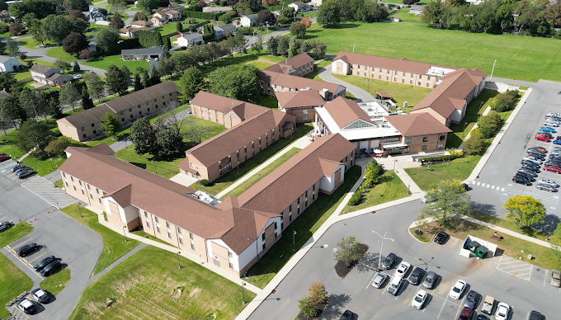
RESIDENCE HALLS
https://www.northampton.edu/student-experience-and-support/housing-and-residence-life/
Application
Fees and Meal Plans
Immunizations
myRecordTracker®
Email:
residencelife@northampton.edu
AK

Slide 11
NCC TEXT ALERTS
Sign up for Emergency Text Alerts at:
https://northampton.omnilert.net/subscriber.php
Weather Alerts
Campus Emergencies
College Closing Information
Child Care Information
Residence Students
AP

Slide 12
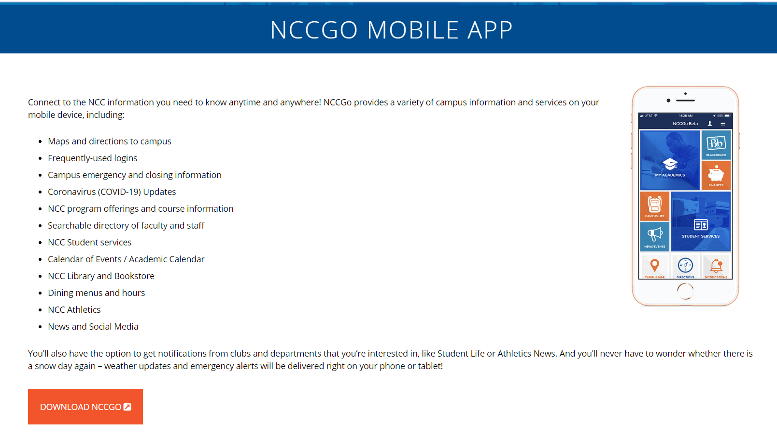
https://www.northampton.edu/nccgo.htm
AP

Slide 13
CLASS SCHEDULE
What will the class schedule look like?
Online Classes – Synchronous and Asynchronous
Hybrid with Lab Component – Lectures Online and Labs On-Campus
On-Campus Classes – Combination of Remote and On-Campus
On-Campus Classes – Completely On-Campus
Check your schedule for Changes in Dates and Times!
AP

Slide 14
ADMISSIONS OFFICE
Millie Roman-Buday– Director of Admissions
Conditional Students
Must meet conditions/requirements of all courses in progress
Final Transcripts
If finishing classes at another school, please be sure to send your final transcripts to the processing center at NCC
Contact Admissions at adminfo@northampton.edu
JPB

Slide 15
ADVISING AND REGISTRATION INFORMATION
David Repyneck– Success Navigator/Advisor for Health Science Programs/Majors (drepyneck@northampton.edu)
Virginia Coleman – Associate Director of Advising and Transfer (vcoleman@northampton.edu)
https://nacc.sharepoint.com/sites/WorkdayStudentSystem
https://www.northampton.edu/admissions/register-for-classes/registration-faqs.html
AP

Slide 16
HEALTH PROFESSIONS RESOURCE CENTER
https://www.northampton.edu/education-and-training/programs/health-professions-resources.html
Acceptance Checklists for each Program/Major
Recorded PowerPoints for further clarification on Acceptance Checklists including background clearances, health requirements, and myRecordTracker®
Essential Functions for each Program
Health Forms and OSHA Form
Resource Links for BLS, Disability Services, Health Center, Workday
JB

Slide 17
HEALTH FORM OVERVIEW
Tracy Newman – RN, NCC Health & Wellness Center
Physical Exam
Immunization Records
Titers
TB Testing
https://www.northampton.edu/campus-life/health-and-wellness-center.htm
NCC Health and Wellness Center
Main Campus
College Center 120
610-861-5365
HealthCenter@northampton.edu
JB

Slide 18
myRecordTracker®
Invitation email will come from myrecordtracker@verticalscreen.com
Check Spam Folder
You may not receive your invitation for up to 2-3 weeks after you receive your acceptance letter! Please be patient! After 3 weeks, contact your Program Director.
Troubleshooting: Shawn Fortley, Healthcare Records Coordinator - sfortley@northampton.edu
Background Clearances
myRecordTracker Questions
Uploading Concerns
JB

Slide 19
Background Clearances
There are three background clearances needed for most programs
PA State Police (PATCH) – Cost $22.00 – DO NOT DO VOLUNTEER VERSION
FBI Fingerprinting through DHS – Cost $24.95 (cost changed in 2024)
Child Abuse Clearance – Cost $13.00
Read important instructions related to background clearances if there is something in your past history
Contact your Program Director as soon as possible to discuss further steps
JB

Slide 20
Verification of Residency
You will be required to complete a Verification of Residency Form
List current address and any other addresses for the past 2 consecutive years
Provide copy of State-Issued Driver’s License or Photo ID
If you have not lived in Pennsylvania for the past 2 consecutive years, you will be required to obtain another FBI Clearance through the PA Department of Aging
Cost, if needed, is $26.20
JB

Slide 21
Program Orientation and Registration
Program Orientation is mandatory!
Nursing students: Registration opens one week AFTER Orientation
Check your Acceptance Checklist for your program’s Orientation details
Mark the date, time, and room location on your calendar
AP

Slide 22
Dr. Allen Kotun
Dean, School of Health Professions and Science
Email: akotun@northampton.edu
Phone: 610-861-5455
“There are no secrets to success. It is dedication, hard work, and learning from failure.”- Colin Powell
REMINDER…mark the calendar for the Program Orientation & Registration
AK

Slide 23
wishes you success!

